Slide 1
ENGI 301 Putting Speed Control Device Proposal
10/4/2020
Grace Wilson

Slide 2
Background Information
A device that measures the speed at which a golf ball approaches the hole. It will be positioned directly in front of the cup, but out of the line of the putt. Used on flat putting surfaces to help with speed/distance control.
The device will provide visual and audible feedback. The ball speed will be visible on a small display screen, and a speaker will inform the user of the quality of the putt based on its speed:
Slow speeds: ”Barely got there!”
Fast speeds: “A little strong!”
Perfect speed: “Perfect putt!”
The device will utilize IR sensors, a screen display, a speaker, and the Pocket Beagle to achieve this functionality.
The screen will display a short history of the speeds of the last four putts, and the device will be powered on and off with a power button

Slide 3
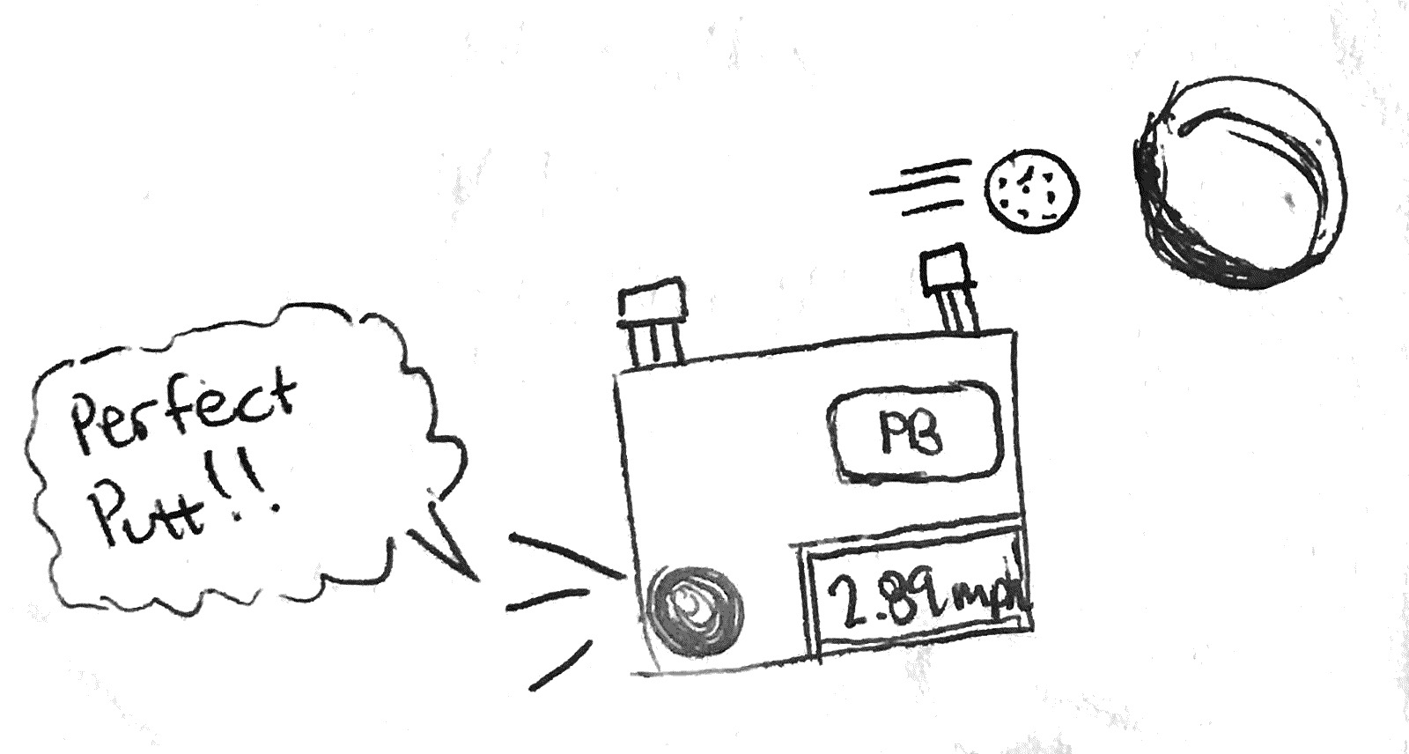
Rough Sketch of Device Design

Slide 4
Existing Solutions
There are a few existing projects that use an Arduino UNO to detect the speed of toy cars passing in front of an IR sensor set up. The projects are linked below:
https://www.hackster.io/yashastronomy/arduino-speed-detector-4eab71
https://www.hackster.io/embeddedlab786/car-speed-detector-d60ea0
https://www.hackster.io/NerdFatherRJ/speeduino-speed-tracker-c8fcae
The improvements that will be made are an added audible component to the device. This audio feedback will allow users to understand the device’s analysis of the putt without relocating from their putting position to check the display screen. Additionally, a PocketBeagle will be used instead of an Arduino.

Slide 5
System Block Diagram
IR Proximity Sensor 1:
GP2Y0A21YK0F
GPIO58/P2_4
Micro USB Power
USB0
IR Proximity Sensor 2:
GP2Y0A21YK0F
GPIO57/P2_6
USB to Audio Jack
USB1
Record Button
GPIO60/P2_2
PocketBeagle
Toggle Up Button
History Button
GPIO60/P2_8
GPIO60/P2_10
20x4 I2C Character LCD Display:
CFAH2004AC-TMI-EW
I2C1 SCL/P2_9
GPIO60/P2_19
Toggle Down Button
I2C1 SDA/P2_11

Slide 6
Power Block Diagram
IR Proximity Sensor 1:
~ 30mA
5V
5V
Micro USB Power
SYS_VOUT
VIN_USB0
IR Proximity Sensor 2:
~ 30 mA
5V
SYS_VOUT
5V
USB to Audio Jack
VIN_USB1
Buttons:
up to 50 mA
1k ohm R
3.3V_VOUT
PocketBeagle
5V
SYS_VOUT
20x4 I2C Character LCD Display:
up to 1.5 mA
SDA
1k ohm R
SYS_VOUT
SCL
1k ohm R
SYS_VOUT
**All components are grounded

Slide 7
Components/Budget
Component | Need to Buy | Cost
Sharp IR Analog Distance Sensors: https://www.pololu.com/product/136 | x2 | $10.29
20x4 I2C Character LCD Display: https://www.crystalfontz.com/product/cfah2004actmiew-20x4-i2c-character-lcd?kw=&origin=pla&gclid=CjwKCAjwq_D7BRADEiwAVMDdHiHPBFW64CMppy-nCaKe0sCETMsAPY2SlfEIacJEAEYCOHrj1hV69BoCuvgQAvD_BwE#undefined | x1 | $15.81
USB to Audio Jack | No
Button for Powering on Device | No

